Slide 1

Cross-Platform Mobile Development in Visual Studio
Notes:
Thanks for coming along.

Slide 2
Who Am I?
Bart Read, Software Engineer, Red Gate Software
Working on Nomad for Visual Studio - http://vsnomad.com/
bart.read@red-gate.com
Twitter: @bart_read
https://github.com/bartread

Slide 3

Notes:
Red Gate’s been around for about 14 years now. We’re based in Cambridge in the UK, but also have offices in Pasadena and Singapore.
Originally we became successful making tools for SQL Server, and in fact we still do this: things like schema and data comparison and synchronization, backup, SQL intellisense.
We’ve also built a successful business around .NET developer tooling with, for example, two of the best profiling tools out there.
More recently we’ve moved into cloud tooling, and of course we also have a mobile offering.
Nomad for Visual Studio is a Visual Studio extension, and corresponding service, which allows you to build cross-platform mobile apps for iOS and Android from within Visual Studio.
And it’s at this point that I have to make a disclaimer, and the disclaimer is this: I obviously have an opinion, and potentially an agenda. I am going to try and subvert that opinion and that agenda as much as possible throughout this talk to give you as balanced and fair an overview of mobile development in Visual Studio as I can. This talk isn’t an advert!
One last thing before we get into it: if you have any questions I’m happy to take them as we go along, so please just call out or raise your hand. Obviously if it gets too in depth or off topic I might say let’s deal with it at the end, or talk after the session.

Slide 4
Notes:
I’m not going to labour the point, but this is why…

Slide 5
Notes:
And here are the figures by operating system.
It’s a similar growth story for tablets - you already know this.
Usefulness in business:
- Looking things up - addresses, navigation, facts and figures
- Meeting agenda and notes
- Document sharing/viewing
- Content consumption rather than creation - but this is changing
- Communication - phone, skype, hangouts, email, messaging services, etc.
- Network provisioning/mobile access point
- Presentation notes! (Rather than cards, presenter view in Powerpoint, etc.)

Slide 6

BUSTED!
Notes:
Of course, as useful as these things are, they can be a distraction...

Slide 7





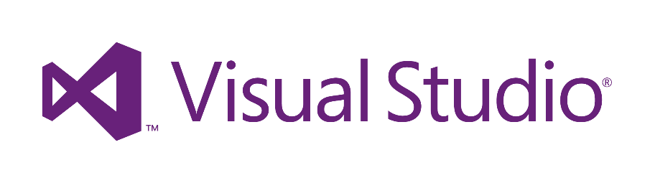


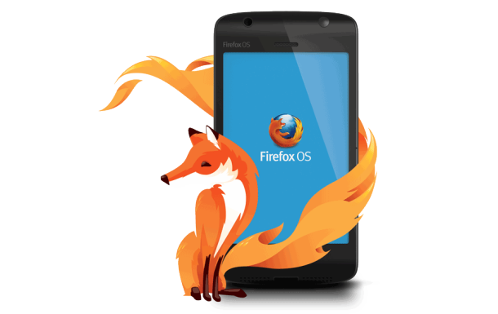


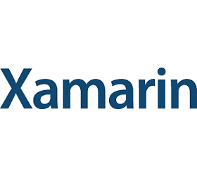



Notes:
There are many different options available for mobile development, some more applicable to different use cases than others.

Slide 8
These options all boil down to…
Native
Hybrid
Mobile Web
Other/Fringe/Exotically Proprietary
Notes:
They basically boil down to:
Native – i.e., developing for iOS with Objective C and XCode, Android with Java and either Eclipse or IntelliJ, or even Xamarin, which really falls somewhere between native and hybrid
Hybrid – apps built with web technologies packaged in a native wrapper – these are the kind of apps you’d build with Nomad
Mobile Web – literally just building a mobile optimised version of your website with technologies such as jQuery Mobile, and often employing responsive web design techniques to better handle different form factors
Other/fringe/exotically proprietary – an example here would be something like Appcelerator Titanium, where you’re writing JavaScript but it’s against Titanium’s proprietary APIs and is ultimately compiled down to native code

Slide 9
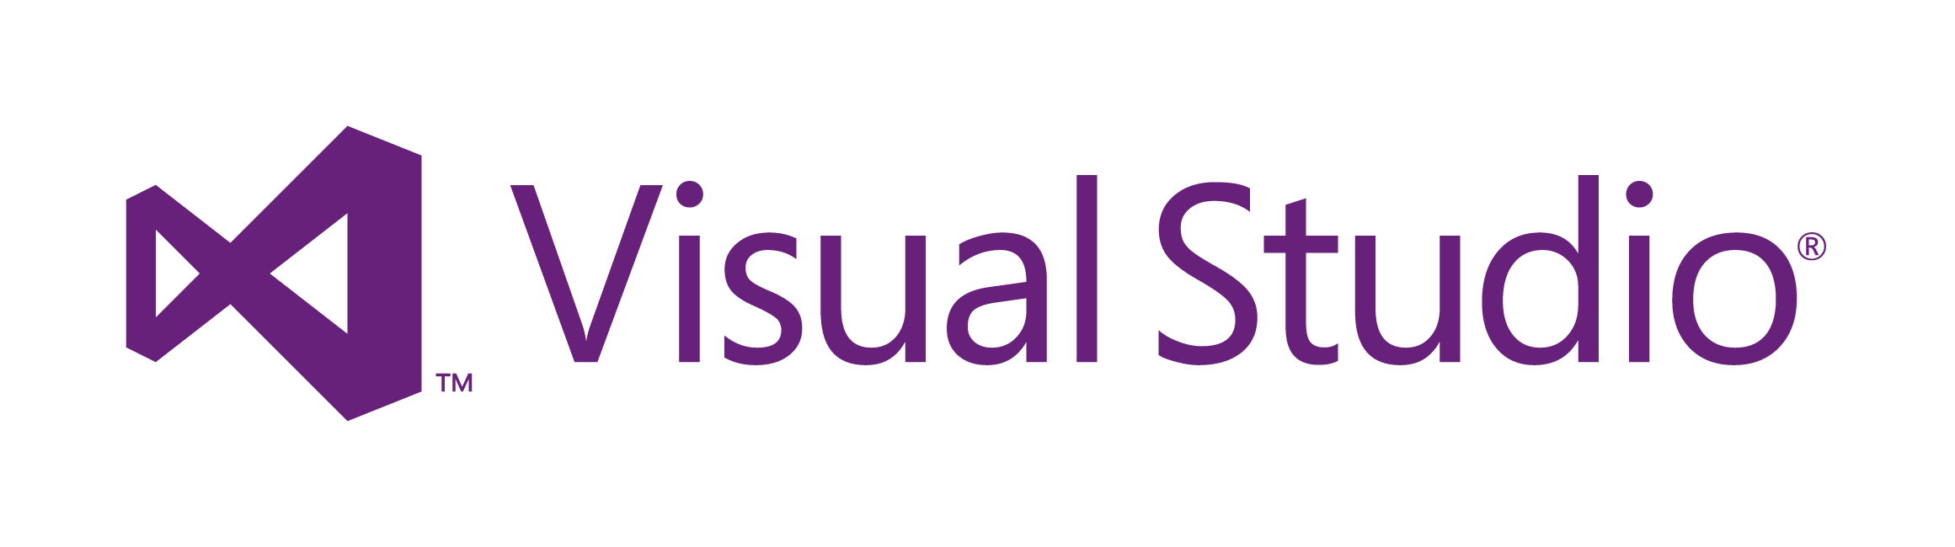
Notes:
I have an easier job here today though because I’m talking only about the options available in Visual Studio, of which there are only two at present:
Nomad, the hybrid solution that I work on, which supports iOS and Android
Xamarin, which allows you to build native apps for iOS, Android and WP8 using C#
Soon I expect Telerik’s Icenium will also feature, though goodness knows how I’m going to shoehorn a third option into this talk without it turning into some sort of horrific 3 hour epic Hollywood/Powerpoint chimaera.
(You can also roll your own solution by locally installing PhoneGap/Cordova or using PhoneGap Build, and develop your app in Visual Studio, but you’re not going to get any advantage from using VS over any other IDE in this situation, except perhaps familiarity, because there’s no integration between Cordova or PhoneGap Build and VS.)
But hold on: why would you want to use Visual Studio anyway when you have all these other options available?
I suppose what I’d say is that if you’re not already using Visual Studio, and don’t plan to for other work, then feel free to choose one of the other options that suits you better.
But if you’re a Visual Studio developer - how many of you are? You’ve already got a significant body of work in Visual Studio: solutions, projects, web apps, services, etc. And the mobile app you’re planning to develop is probably a complement to some portion of that body of work.
And you’re used to Visual Studio and all it has to offer: projects, powerful editors, intellisense, relative ease of use, debugging, and all that good stuff.
Why wouldn’t you want to develop in Visual Studio when moving to another toolset is just going to slow you down?
(I suppose Douglas Coupland’s concept of “option paralysis” – from Generation X – is helpful here too. Your job is going to be a hell of a lot easier if you can quickly whittle the extensive list of available choices down to only a few options.)

Slide 10
Notes:
OK, so let’s talk about these two options, Xamarin and Nomad. I’ll deal with Xamarin first.
Well… Xamarin are obviously a competitor of ours but I’ve got a lot of respect for them: they have some genuinely cool tech and, for some requirements are absolutely the obvious choice.
Xamarin rose from the ashes of Attachmate’s acquisition of Novell, which saw them let the entire Mono team go. I don’t know how that felt for Miguel and the Mono guys but, from the outside, at the time it looked like a terrible thing. Arguably though it’s turned into a blessing in disguise.
Xamarin allows you to write cross-platform mobile apps for iOS and Android in C# using Visual Studio, or their own Xamarin Studio IDE. Since we’re interested in Visual Studio we’ll ignore the latter.
Although the Windows Phone libraries aren’t part of Xamarin - you need the Windows Phone SDK from Microsoft, obviously - because you’re writing in C# you can still share code between your iOS, Android and WP8 apps.
Your business logic, data layer, services layer, and other app backend components are shared between all versions of your app - or at least they are if you get your architecture right! The UI however is platform specific.
Xamarin gives you access to the complete set of iOS and Android APIs by exposing through standard .NET namespaces. It also provides tooling such that you can generate .NET bindings for any third party iOS or Android libraries you might want to use. You can think of Xamarin as providing a thin wrapper around the native APIs whereas, in contrast PhoneGap/Cordova, which I’ll get to shortly, abstracts them away entirely.
Now, whilst you’re writing code for all three platforms (potentially), and probably in a single solution, in C#, the way that code is built, packaged, deployed, and run for each of the supported platforms is quite different.

Slide 11
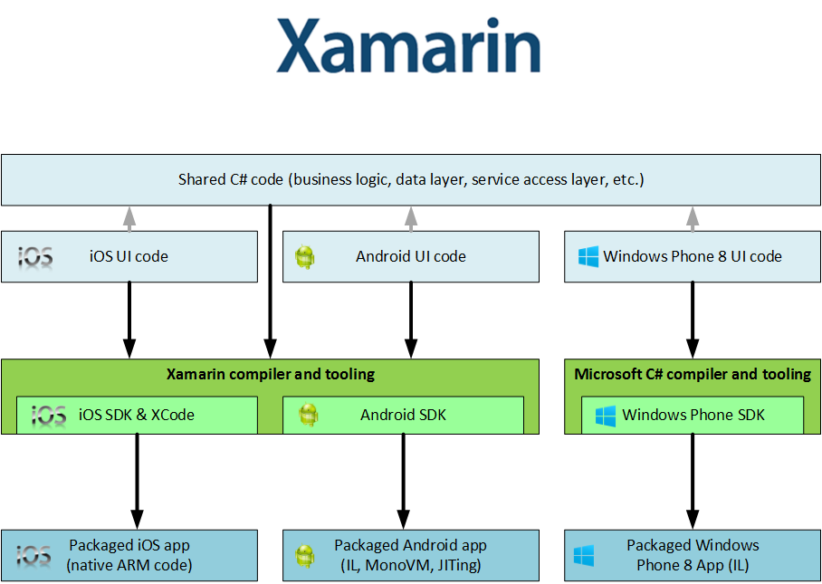
Notes:
iOS
For iOS the Xamarin compiler cross-compiles straight to ARM code, and the linker uses static analysis to eliminate unused types from the final deliverable - this really shrinks it down because you’re not having to include the entire .NET framework, along with a load of code you’re just not using.
It does impose some limitations on the language features you can use though, mostly around generics. You can use generics, but some things won’t work - Xamarin have extensively detailed these limitations on their site.
Apple don’t allow any code generation at runtime, so this means that things like System.Reflection.Emit, and anything built on it (like the DLR and any DLR languages, along with a load of other stuff) also won’t work.
All of this adds up to a cut down version of the .NET API that’s mostly equivalent to the core Silverlight APIs (NOT the UI controls, obviously), with a few extra bits tacked on. Nonetheless, many third party libraries are compatible Xamarin and can still be used - e.g., SQLite.
Android
Android is somewhat different: the code is compiled to IL, and then packaged up with MonoVM and JITing support. The Android native APIs are used via JNI. Again the linker prunes out any code that isn’t used via static analysis. As you’d expect, anything access purely reflectively will be missed by it.
There are again limitations, which are different from the iOS limitations, as you’d expect. For example, there is some partial support for DLR. Not entirely surprisingly there are (somewhat different) limitations with generics.
Again, these are all well documented on the Xamarin site.
WP8
Windows Phone is supported by the Visual Studio tooling and the Windows Phone SDK. .NET assemblies are built from your code and run in the core .NET runtime common to both WP8 and W8, so everything should behave as you’d expect.
Clearly there’s the potential for the platform differences I’ve mentioned here to lead to differences in behaviour and subtle, or not-so-subtle, bugs on different platforms, which is something you need to be aware of.

Slide 12
Pros
Cons
C#
Native look
Near-native performance
Full access to native APIs
More code; less sharing
Maintenance
Need to know native APIs
Platform quirks
Need Mac to build for iOS
Use for: performance, native experience
Notes:
So there are some definite advantages to this approach:
- You get to code in C#, which is a great language,
- Your app will be indistinguishable from a native app, particularly if you’ve taken the trouble to follow the UI style guides for each platform,
- You should get near-native performance,
- You have full access to the native APIs so can take full advantage of device capabilities,
There are some downsides though:
- You’re going to have to write more code - UI code can’t be shared
- The platform specific code leads to additional maintenance overhead; if you architect your app wrongly you can find yourself in a position where very little code is shared between platforms
- You need to know the native APIs for each platform you want to support
- Language limitations and quirks between platforms could trip you up - in practice, is this likely to be any worse than the kind of issues that can occur when everything’s hidden away behind an abstraction layer like Cordova? Probably not – it’ll just be different
- You need a Mac to build for iOS, even if you’re developing your app in Visual Studio.
So when should you use Xamarin?
- When native, or near-native, performance is critical - though you should ask yourself whether you really need to be doing this much heavy lifting on device, because it will pummel the battery life.
- When you absolutely positively need to offer a platform specific experience indistinguishable from a native app; arguably for business apps this may be never, because you may be better served (and serve your users better) by offering a common experience across platforms.

Slide 13


Notes:
Moving on, I’ve mentioned PhoneGap (or Cordova) and the fact that Nomad is built on it quite a few times now without really explaining myself.
Let’s start with a bit of history.
Some years back a company called Nitobi developed a technology called PhoneGap, which allowed developers to build mobile and tablet apps using front-end web technologies: HTML5, JavaScript, CSS.
PhoneGap works by abstracting native device APIs in an OS specific native layer that exposes a common cross-platform API through JavaScript. This means that you can use the same API to access camera, contacts, accelerometer, sound capture, compass, GPS, along with other device functionality regardless of whether you’re writing an app for iOS, Android, Blackberry or Windows Phone.
Apps built with PhoneGap are known as hybrid apps because they are always a hybrid of a native wrapper or shim within which your HTML5 and JavaScript runs, inside the platforms native web view. Nowadays when people talk about hybrid they generally mean that everything about the app that makes it the app is written in HTML5 and JavaScript, and the native part is all provided by PhoneGap - i.e., it’s just the wrapper and framework within which your app runs.
However, PhoneGap also allows you to write an app using native code that includes embedded web components for some functionality. I’d suggest this is where the term hybrid really comes from. Nowadays when I write a mobile app I’m only working with web technologies and don’t generally care at all about the native parts - PhoneGap handles that all for me.
OK, so that explains PhoneGap, but what’s this Cordova thing?
Some time after Nitobi began developing PhoneGap, they were acquired by Adobe. Adobe then open sourced PhoneGap and handed over to The Apache Software Foundation, but kept the PhoneGap trademark. Thus, PhoneGap is now known as Cordova. Think of it as being the same as the relationship between Linux and, say, Ubuntu - PhoneGap is like a branded distro of Cordova.
In my view Adobe deserve a lot of props for what they’ve done here, and even more for the fact that they still employ a team to work on Cordova full-time, and curate many of the most commonly used plug-ins.

Slide 14
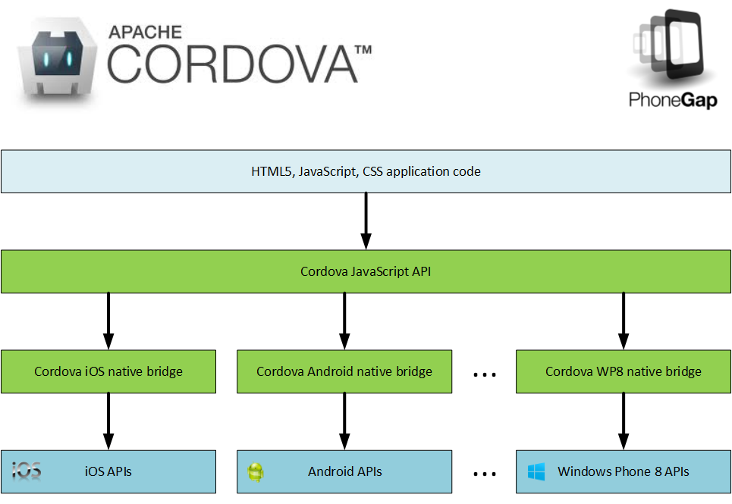

Slide 15
The Cordova JavaScript API
Accelerometer Camera
Capture Compass
Connection Contacts
Device Events
File Geolocation
Globalization InAppBrowser
Media Notification
Splashscreen Storage
Plug-ins: https://github.com/phonegap/phonegap-plugins

Slide 17
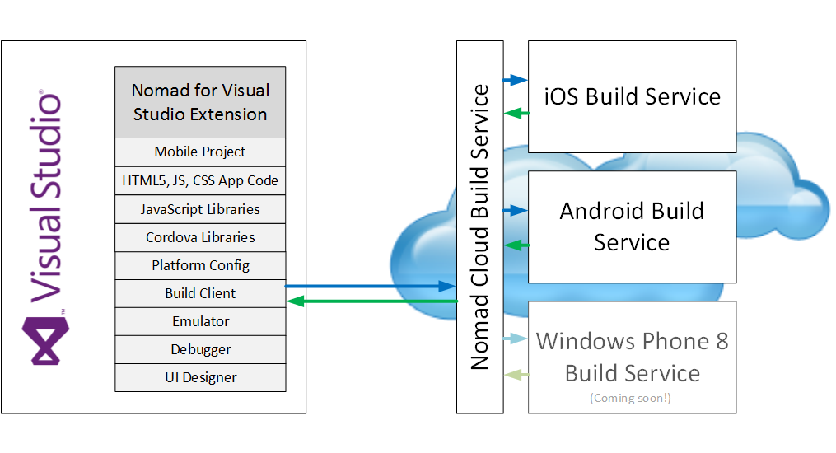

Slide 18
Pros
Cons
HTML5/JavaScript/CSS
Write once for all platforms
Simple, unified device API
Simple setup
Don’t need a Mac*
Future-proof; no lock-in
Non-native UX
Performance
No great Windows solution**
Use for: simplicity, delivery time, maintenance

Slide 19

But wait: why not just use mobile web instead?

Slide 20
Windows Phone 8 and Windows 8/RT Development Resources
http://msdn.microsoft.com/en-us/library/windowsphone/develop/jj681690(v=vs.105).aspx - Windows Phone 8 and Windows 8 platform comparison
http://msdn.microsoft.com/library/windowsphone/develop/jj714089(v=vs.105).aspx - Windows Phone 8 and Windows 8 app development
http://msdn.microsoft.com/en-us/library/windowsphone/develop/jj721614(v=vs.105).aspx - Handling Windows Phone 8 and Windows 8 platform differences
http://channel9.msdn.com/Series/Building-Apps-for-Both-Windows-8-and-Windows-Phone-8-Jump-Start - Channel 9 - Building Apps for Both Windows 8 and Windows Phone 8 Jump Start

Slide 21

Demo Time!

Slide 22


Slide 23


Slide 24


Slide 25
Demo Resources
TODO: Link to accelerometer sample
TODO: Link to Azure Mobile Services sample
TODO: Links to Nomad sample apps

Slide 26
Coming soon to Nomad…
On-device debugging
A FREE version of the service
Cordova plug-in support
PushNotification
BarcodeScanner
Etc., see https://github.com/phonegap/phonegap-plugins
Windows Phone 8 support

Slide 27
Contacts & Resources
Nomad for Visual Studio - http://vsnomad.com/
bart.read@red-gate.com
Twitter: @bart_read
https://github.com/bartread
Using Nomad to create an app with Azure Mobile Services: http://www.codeproject.com/Articles/585792/Android-and-iOS-Mobile-Device-Development-with-Azu

